Slide 1
AS91896(2.7) & AS91887(2.8) Documentation
Amy Jorgensen

Slide 2
Links:
Link to working program:
Link to trello board / project management tools (e.g. GIST):

Slide 3
Relevant Implications:
Explain the relevant implications here.
Then as you develop your code, discuss how the implications are being Addressed.
Functionality | Involves ensuring that the recipe moderniser allows users to enter ingredients for a given recipe and the program will correctly scale the ingredients and change the amounts into grams (where possible) and millimetres where it is not possible to convert to grams.
Usability | Involves making it possible for people to use an outcome without needing to ask for help. For my recipe moderniser, this would mean that the user can easily input ingredient amounts (and units), and invalid inputs are not allowed. This would make the program less frustrating to use
Accessibility | Means ensuring that all users can access the outcome and its content. One issue with sharing Python programs is that if the program is simply uploaded to a web server / shared via email, users would need to install Python to be able to use it. We can overcome this limitation by making the code available through a web platform like repl.it
Social Implications | Relate to how our outcome might affect society as a whole. In the case of the recipe moderniser, it is hoped that the program will benefit most communities as it should make it easy to share recipes and will hopefully encourage users to cook food at home (which is often cheaper and more healthy compared with other options).

Slide 4
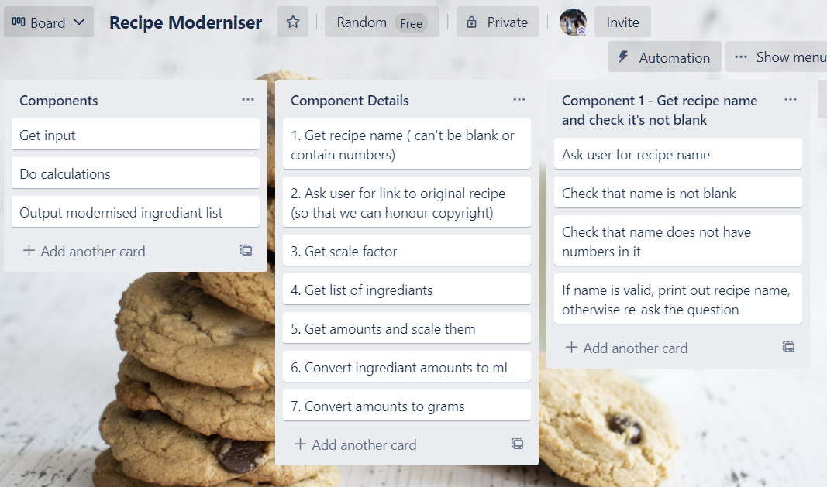
Decomposition:
Task Components:

Slide 5
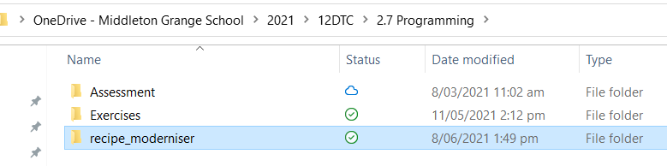
Version Control Evidence 1:
First I set up my logical folder structure in my OneDrive. This was so that I can have access to my files both at home and at school.
I called the project recipe_moderniser
Every component I create as part of this project will be saved in this folder.

Slide 6
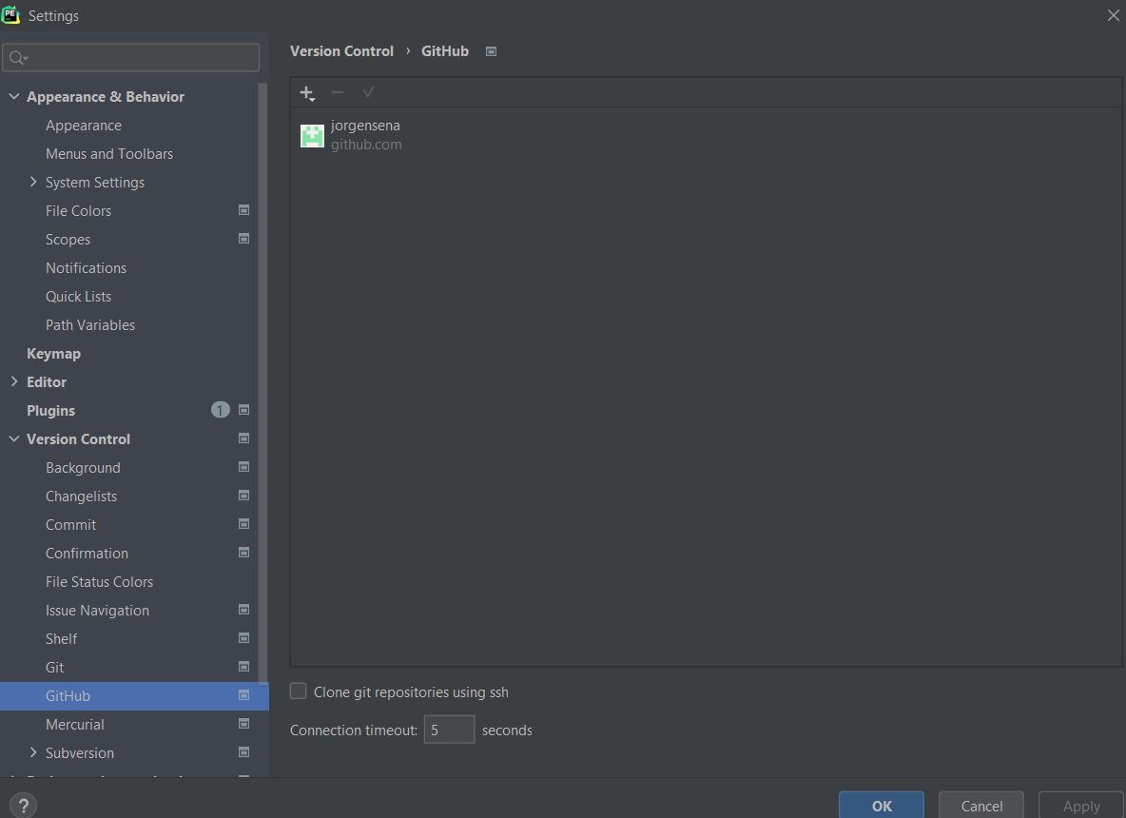
Version Control Evidence 2:
Then I set the version control for this project using GitHub. To do that I had to create a GitHub account and then set the version control properties in the Pycharm project to the GitHub account I had created.

Slide 7
Component Testing:
Show that you have developed and tested each component here. You should have a test plan and then screenshot proof for each component. You can also include notes that justify the major decisions you made.

Slide 8
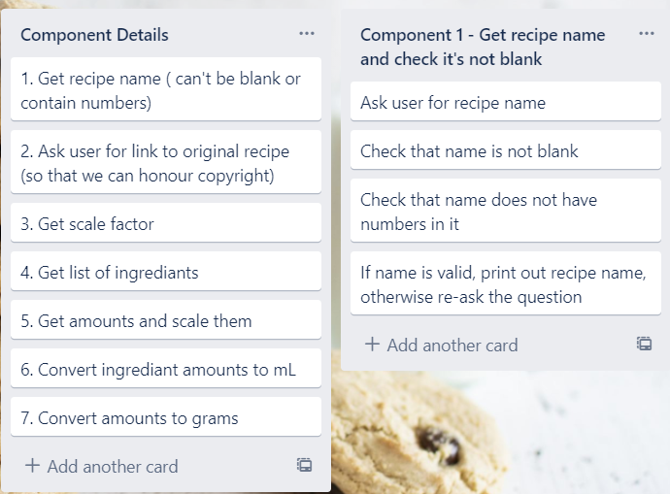
Component 1 (Trello screenshot)

Slide 9
Component 1 - Test Plan
Test Cases - input | Expected output
“Anzac Biscuits” | “You will be making Anzac biscuits”
“” < blank > | Error message
“anz4c” | Error message
This component will be developed as a function as the ingredient name can’t be blank either and I will be able to reuse the code. It is important that the program works as expected (functionality). We also want to make it easy to use. By preventing users from making mistakes like leaving the recipe name blank and checking that this works as expected. I am addressing both those implications.

Slide 10
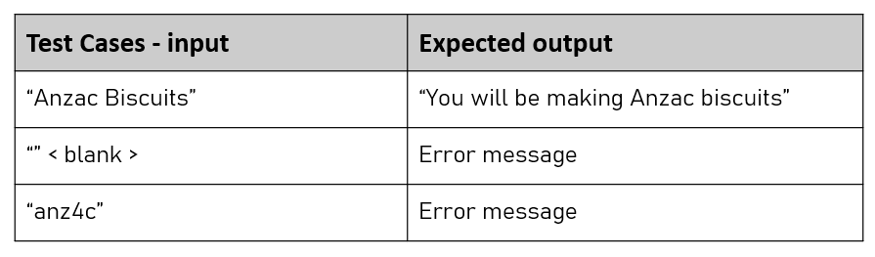
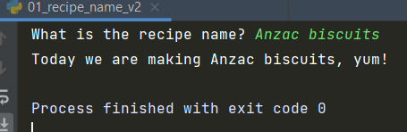
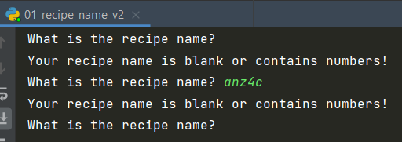
Component 1 – Screenshot of test

Slide 11
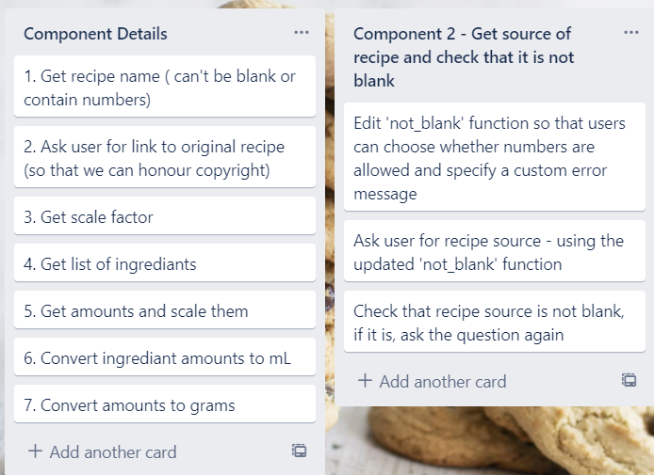
Component 2 (Trello screenshot)

Slide 12
Component 2 - Test Plan
Test Cases - input | Expected output
“” < blank > | Error message: “Please provide the original source/URL for the recipe”
https://edmondscooking.co.nz/recipes/biscuits/anzac-biscuits/ | “You have provided a valid source.” (i.e. The program will continue if the URL does not contain numbers)
https://www.allrecipes.com/recipe/278180/greek-yogurt-blueberry-lemon-pancakes/ | “You have provided a valid source.” (i.e. The program will continue if the URL does contain numbers)
This component will build on the previously created ‘not_blank’ function so that users can specify an error message and can also choose whether numbers are allowed in the response

Slide 13
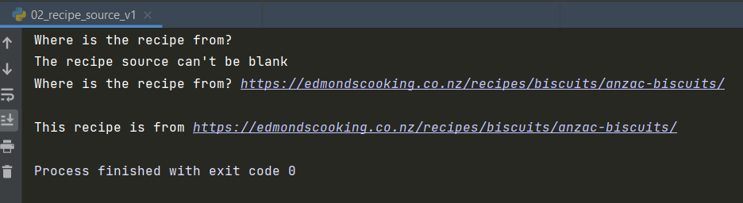
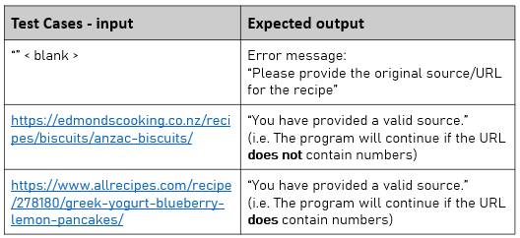
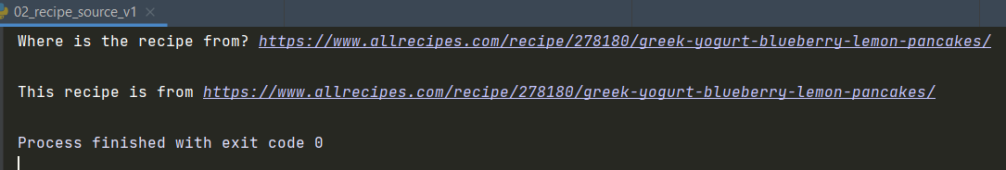
Component 2 – Screenshot of test

Slide 14
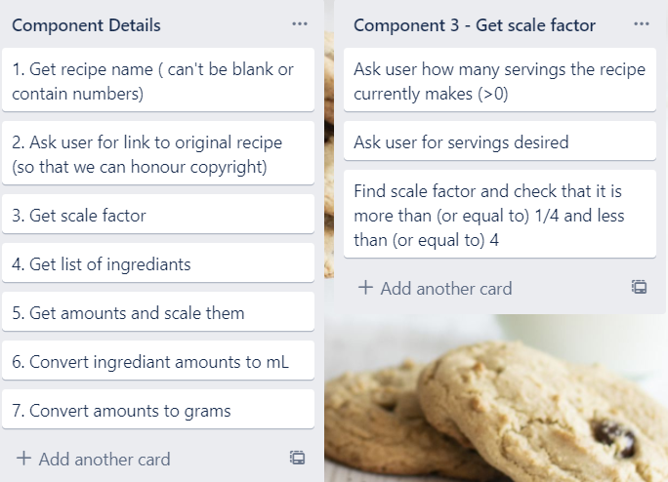
Component 3 (Trello screenshot)

Slide 15
Component 3 - Test Plan (servings_given)
Invalid/Boundary Input
Test Cases - input | Expected output
xiii | “Please enter a number”
0 | “Please enter a number that is more than 0”
0.1 | Program continues
Numeric input will be checked with a number checking function which can then be used to check recipe amounts are valid.

Slide 16
Component 3 - Test Plan (servings_needed)
Invalid/Boundary Input
Test Cases - input | Expected output
xiii | “Please enter a number”
0 | “Please enter a number that is more than 0”
0.1 | Program continues
Numeric input will be checked with a number checking function which can then be used to check recipe amounts are valid.

Slide 17
Component 3 - Test Plan (whole function)
Expected input – includes boundary testing
Test Cases - input | Expected output
How many servings does the recipe make? 4 Servings needed? 1 | Scale factor: 0.25
How many servings does the recipe make? 4 Servings needed? 16 | Scale factor: 4
How many servings does the recipe make? 5 Servings needed? 1 Change scale factor – Yes Servings needed? 2 | Scale factor: 0.2 Warning! This scale factor is very small and you might struggle to accurately weigh the ingredients. Please consider having more servings and freezing the left overs. Scale factor: 0.4
How many servings does the recipe make? 4 Servings needed? 17 Change scale factor – No | Scale factor: 4.25 Warning! This scale factor is quite large and you might struggle to fit everything in the bowl. Please consider having less servings and making more than one batch. Scale factor: 4.25

Slide 18
Component 3 – Screenshot of test

Slide 19
Assembled Outcome Testing:
Please show testing for your assembled outcome below. This should include a test plan followed by screenshot proof.

Slide 20
Usability Testing
Ask a volunteer to use your program and observe them doing so. Write a list of improvements which need to be made based on your usability testing. Then make the required changes.

Slide 21
Post Usability Testing
Show that, having made the required changes from your usability testing, your program works correctly

Slide 22
Relevant Implications:
Please clearly explain how your final outcome addresses the relevant implications.

Slide 23
Final Discussion:
Discuss how the information from planning, testing and trialling of components assisted in the development of a high-quality outcome.

